Slide 1
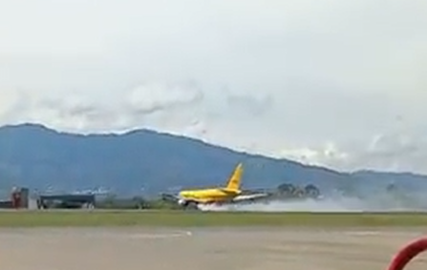
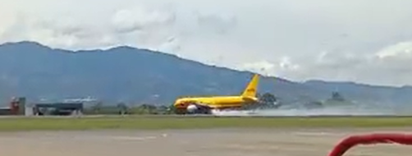
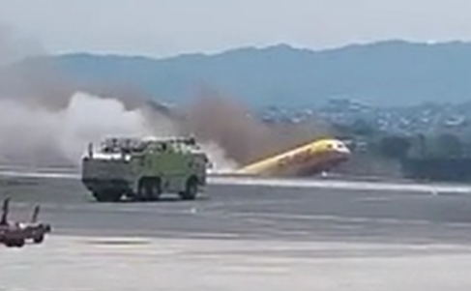
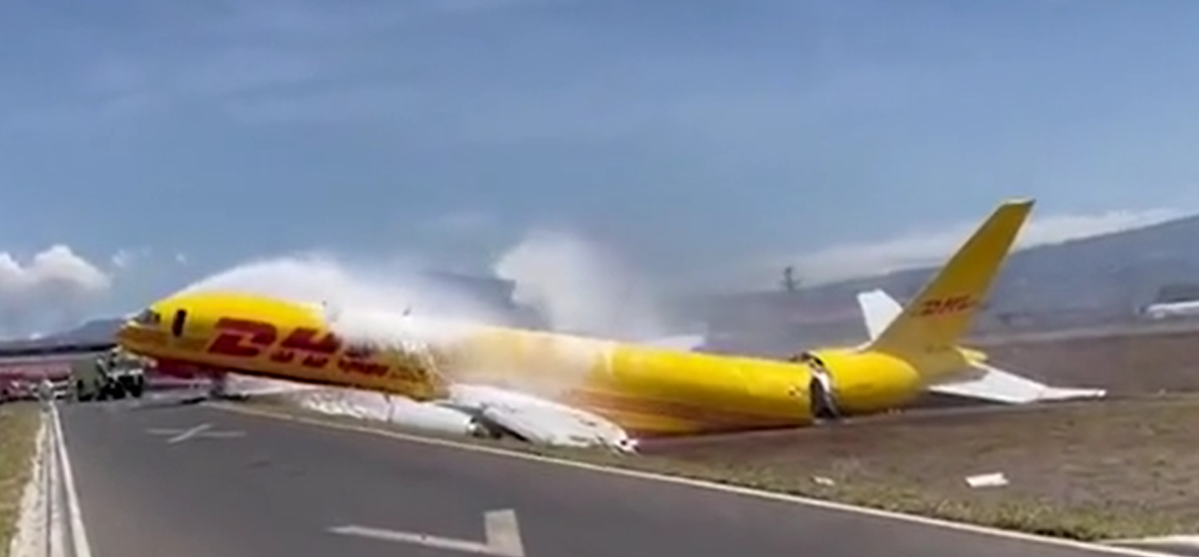

Alliance Sharing
Incident News update (8th Apr 2022)
DHL 757-200 Cargo Fighter Emergency Landing at SJO Broken into 2 half
DHL 757-200 emergency landing
The Cargo fighter just taken off at local time 10:30 7th April 22, due to a mechanical problem, forced to conduct emergency landing back to SJO Juan Santamaria international airport.
Aircraft was broken into 2 half and all crew member safe, only one member under medical observation.
Confirmed with Dangerous Goods on board.
Source : Mr. Tyn van Amelsfoort
Factcheck source : Reuters, Simplflying.com, france24
1
2
3
4
Powered by
www.alliancealliance.com

Slide 2
Alliance Sharing
Incident News update (8th Apr 2022)
DHL 757-200 Cargo Fighter Emergency Landing at SJO Broken into 2 half
DHL 757-200 emergency landing
The Cargo fighter just taken off at local time 10:30 7th April 22, due to a mechanical problem, forced to conduct emergency landing back to SJO Juan Santamaria international airport.
Aircraft was broken into 2 half and all crew member safe, only one member under medical observation.
Confirmed with Dangerous Goods on board.
Source : Mr. Tyn van Amelsfoort
Factcheck source : Reuters, Simplflying.com, france24
Powered by
www.alliancealliance.com

Slide 3
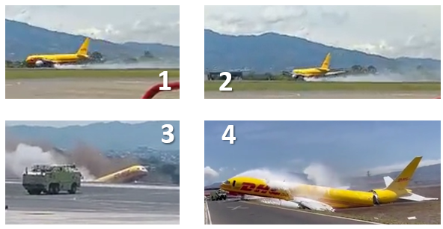
Alliance Sharing
Incident News update (8th Apr 2022)
DHL 757-200 Cargo Fighter Emergency Landing at SJO Broken into 2 half
DHL 757-200 emergency landing
The cargo fighter just taken off at local time 10:30 7th April 22, due to a mechanical problem, forced to conduct emergency landing return to (SJO) Juan Santamaria international airport, Costa Rica. Airport temporary shunt down for few hours.
Aircraft was broken into 2 half and 2 crew members all safe, only one member under medical observation.
Confirmed with Dangerous Goods on board.
Source : Mr. Tyn van Amelsfoort
Factcheck source : Reuters, Simplflying.com, france24
Powered by
www.alliancealliance.com

Slide 4
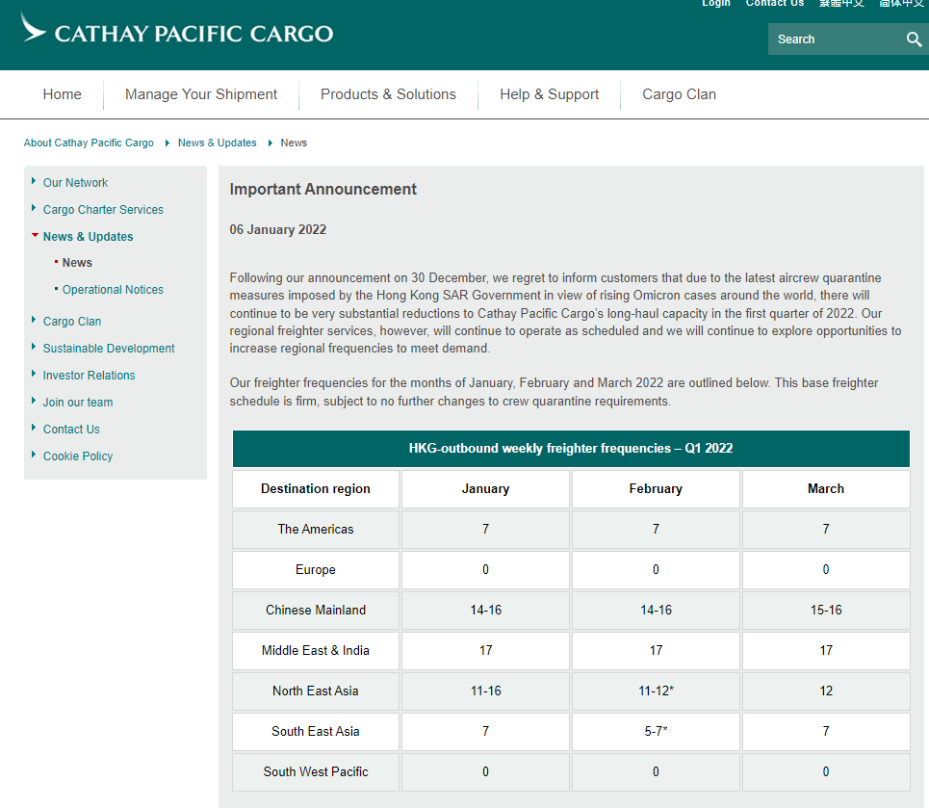
Alliance Sharing Feb 2022
RA / RF Status
Totally 8 new RA registered, and 1 RA are no longer maintaining RA status. Foreseeable with large number of RA will no longer maintaining their RA status.
Compare between Jan & Feb 2022 of registred RA list
New Registred <RA32087> <RA32099> <RA32104><RA32116> <RA32128> <RA32130><RA32142>
No longer valid < RA 27874>
100-150 RA will be gone
In past 2 months, in-active RA, especially the management located in Mainland, who may not be able to come to Hong Kong for either business of maintaining their RA status by their obligation, they also received ‘Advise’ from HKCAD for self-withdraw their RA status, therefore, after 23 months pandemic situation, we expect therefore are 100-150 RA will be no longer maintaining their RA status within this year.
Alliance Advise; pls keep your business partner monitor closely and reminding your business above the source of shipment and the cargo status for avoiding unnecessary hassles.
RF ??
Continue of the tighten policy of quarantine for air crew, reduced schedule fright for both passenger and cargo fighter.
Under Latest HK SAR Pandemic policy, more international freight schedule are reduced or cancel, which affecting the overall payload, especially to certain destinations. Details need to keep update with corresponding carrier.
Exporting new routing is one of the activities for proacting cargo agents.
Industry partitioner still optimistic to the situation, although the number of infection cases rising both local and internationally, because some people believe both global and China policy to new omicron case may have different handling policy, hopefully the situation may change after Feb.
Tel : (852) 2331 8775
Fax : (852) 2331 8609
www.alliancealliance.com

Slide 5
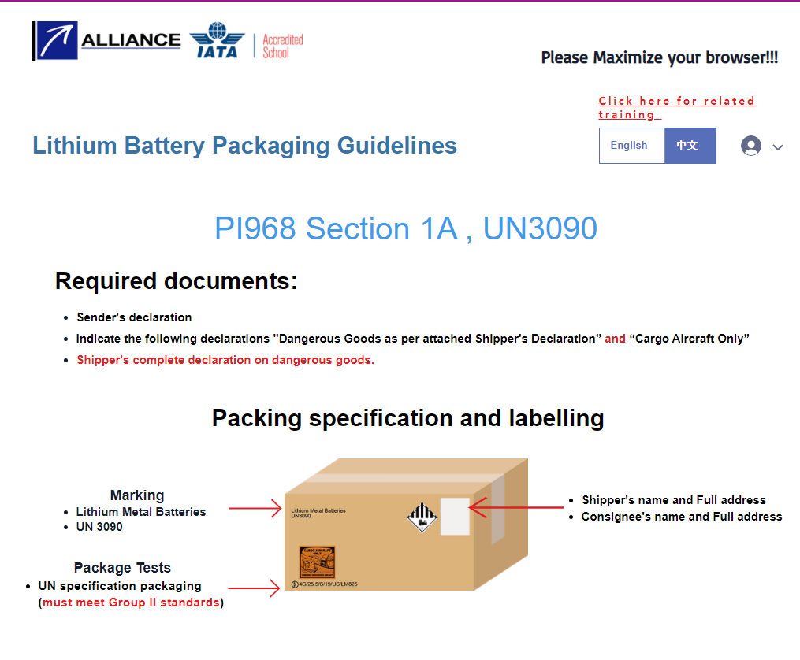
Alliance Sharing Feb 2022
Incident / Accident
Incident of China Airline ORD incident may have Hong Kong involved the HKG-TPE –(CAN / ORD) shipment.
CI5240 from TPE-ANC-ORD 747-400 freighter involved in an accident, aircraft engine damage after colliding with baggage cart while taxing after landed ORD, no one injured.
Advise from Alliance to GBA Aviation Logistics Player
Recommended to check any shipment Via TPE to US. Which is possible involved Hong Kong or GBA US shipment in this China airlines accident in ORD- 28Jan Some shipment because of the TSA security reason may took HKG- TPE - US (ANC, ORD)
Pictures from social media
Tel : (852) 2331 8775
Fax : (852) 2331 8609
www.alliancealliance.com

Slide 6




Alliance Sharing Mar 2022
New Services! Lithium Battery Q check
鋰電池快速測試
To convenience the industry for identify the RIGHT packaging of lithium battery shipment, Alliance developed a new ‘Lithium battery Q Check’ for the industry, simple, no need to check the DGR Manual …..
S
Pictures from Allaince website
Lithium Battery Q check 鋰電池快速測試
Lithium Battery Q check
鋰電池快速測試
Only 1 kick………………..
and answer few questions…..
Result just prop up!!!
Result just prop up!!!
Packing, shipping requirement all show in one page,
Label marking…..never miss and never be massive
Let’s talk to us, if you want at your web page !
Try link : www.allaincealliance.com
Tel : (852) 2331 8775
Fax : (852) 2331 8609
www.alliancealliance.com

